Slide 1
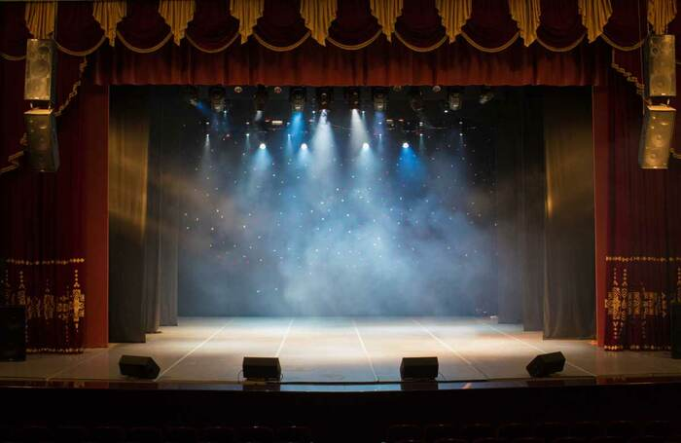
EVENTBRITE

Slide 2




ABOUT THE PROJECT
[Title of Site] is an event finder site used to locate fun, upcoming events in your area.
The site will return suggested events located within a given area specificized by the user
The site will also return the weather forecast for the area that is being searched

Slide 3
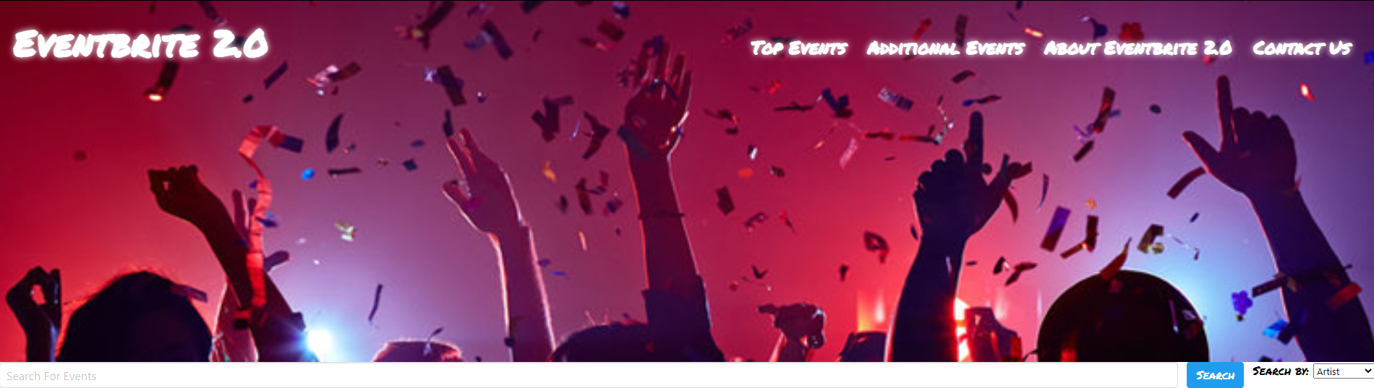
MOCK UP

Slide 4
Video

Slide 5
SUCCESSES AND CHALLENGES
What went well?
The team worked well together to use our strengths while also growing in areas we were less confident in
What could have gone better?
Any practice with a team sharing a repo beforehand would have been helpful

Slide 6

Where were my roadblocks?
Getting the whole team together for a meeting due to work schedules
How did I move through roadblocks or setbacks?
Met separately, used Slack to update team on what each person was working on

Slide 7
What strategies might I use next time to get better results?
More clearly defining the project requirements in the beginning
More tickets on the Kanban board
What do I need to strengthen my understanding in?
Javascript and getting APIs to talk to each other/ work together
How might I go about this?
More practice

Slide 8
FUTURE IMPROVEMENTS
Carousal with clickable links Carousal images that update dynamically Implement a calendar feature
Shopping cart for users to check out Ability to create user account, app would track past purchases and suggest future purchases

Slide 9

LIST OF TECHNOLOGIES USED

Slide 10
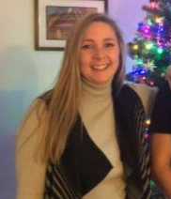
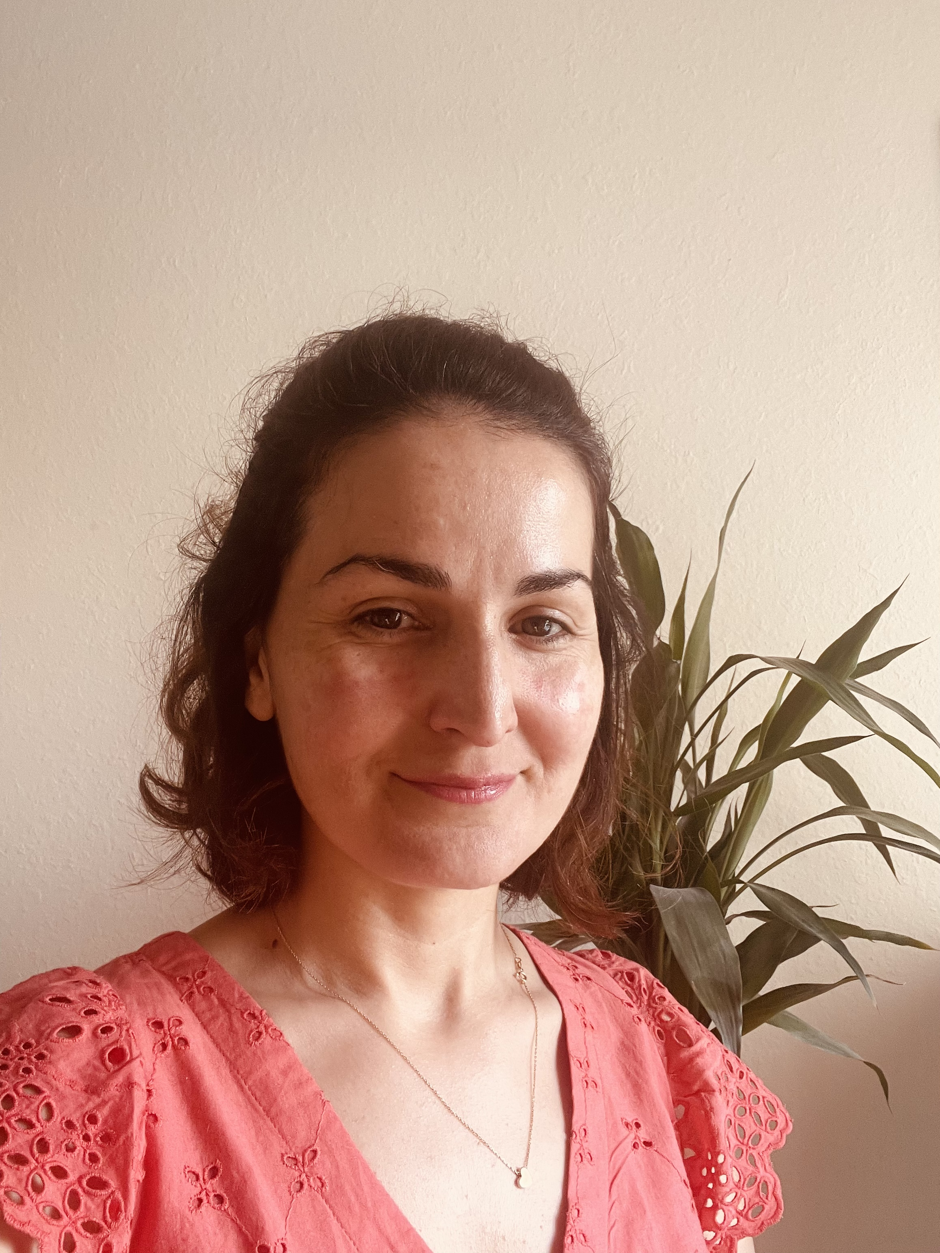

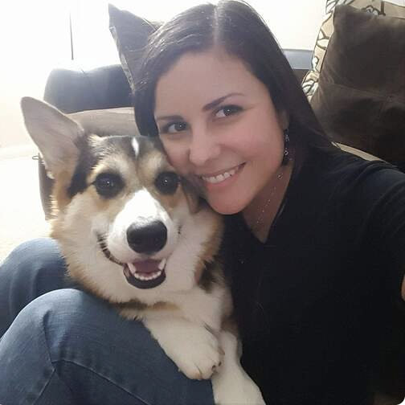
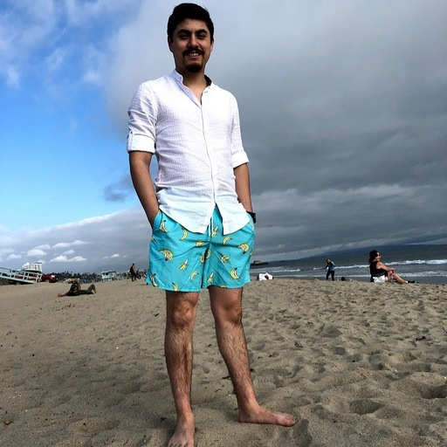
ABOUT THE MAKERS
Dana BOTTONI | Daniel CARAZO | Karla ROMERO | Devin SIMPSON | Sevim GULOGLU
JAVASCRIPT API’s | HTML CSS | JAVASCRIPT HTML CSS | JAVASCRIPT API’s | POWER POINT ABOUT US

